Slide 1
Conformal Prediction with Temporal Quantile Adjustments
2/16/2024

Slide 2
Background
Predicting patient outcomes using physiological time-series data
A population of patients composes a cross-section
Want to estimate coverage across 2 settings:
Cross-sectional coverage (across a cohort of patients) (will not hold for an interaction graph)
Longitudinal coverage (across the temporal dimension) for each time series

Slide 3
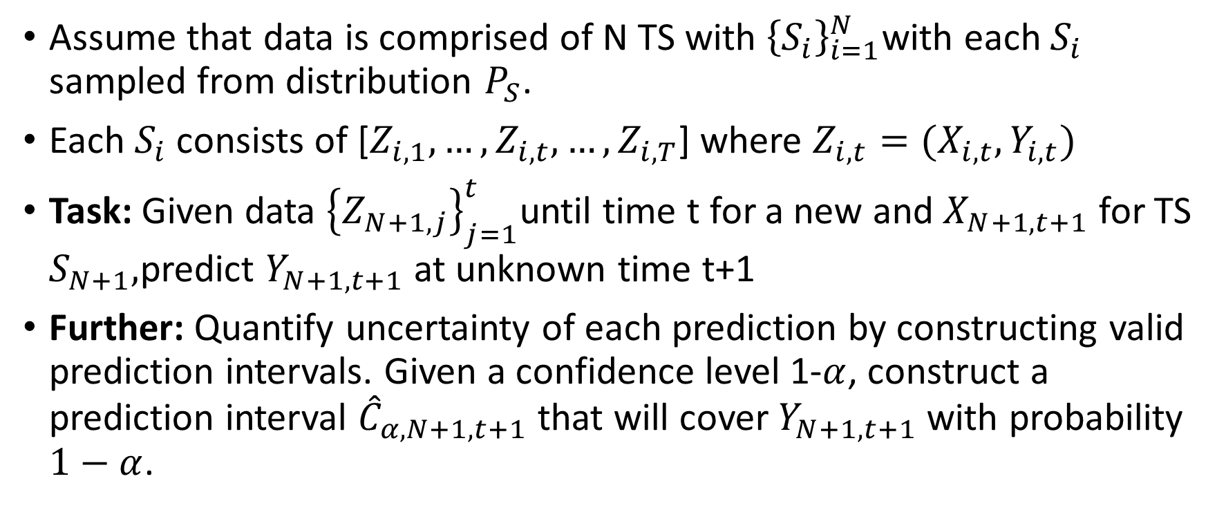
Setting
Assume that data is comprised of N TS with ${\left\{S_{i}\right\}}_{i=1}^{N}$with each $S_{i}$ sampled from distribution $P_{S}$.
Each $S_{i}$ consists of [$Z_{i,1},…, Z_{i,t},…, Z_{i,T}$] where $Z_{i,t}=(X_{i,t}, Y_{i,t})$
Task: Given data ${\left\{Z_{N+1,j}\right\}}_{j=1}^{t}$until time t for a new and $X_{N+1,t+1}$ for TS $S_{N+1},$predict $Y_{N+1,t+1}$ at unknown time t+1
Further: Quantify uncertainty of each prediction by constructing valid prediction intervals. Given a confidence level 1-$α$, construct a prediction interval ${\hat{C}}_{α,N+1,t+1}$ that will cover $Y_{N+1,t+1}$ with probability $1−α$.

Slide 4
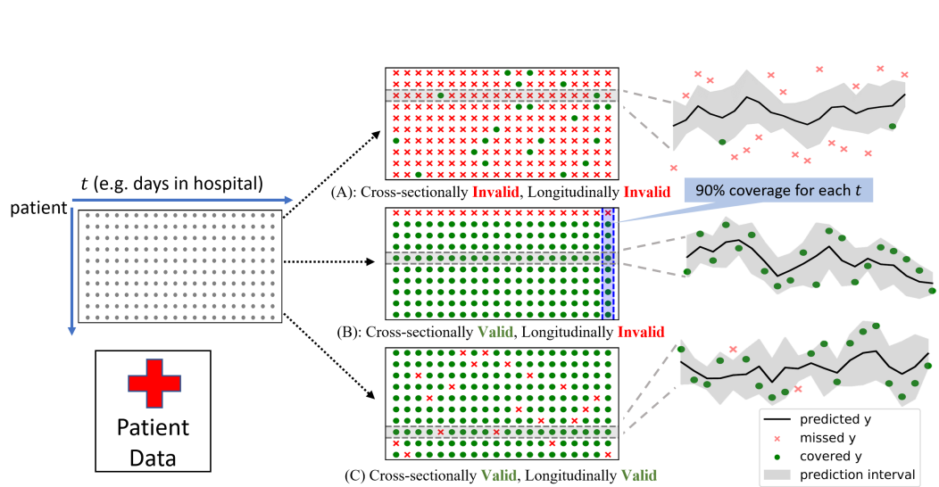
Validity
Longitudinal validity: Validity along the temporal axis for each time series
Cross-sectional validity: validity across the populational cross-section of the time series data

Slide 5
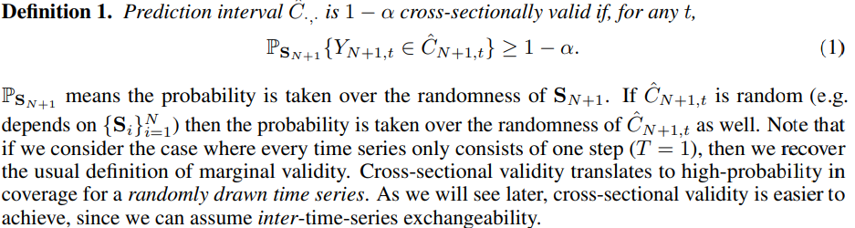

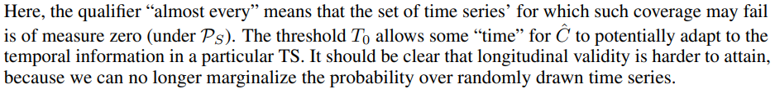
Cross-Sectional and Longitudinal Validity

Slide 6
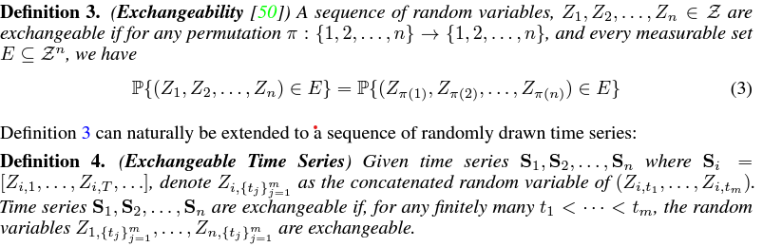

Cross-Sectional Valid PI

Slide 7
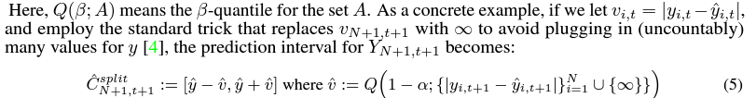
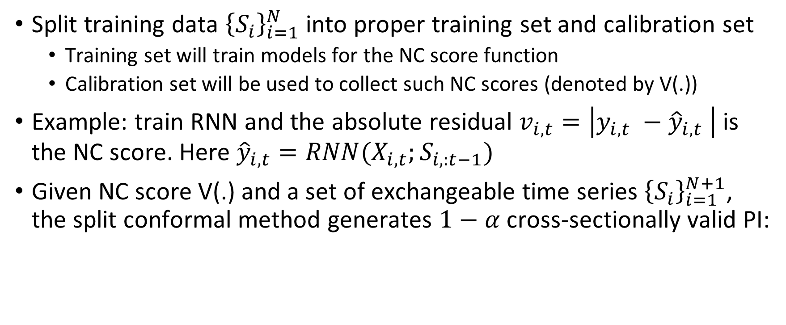
Constructing Cross-sectionally valid PIs
Split training data ${\left\{S_{i}\right\}}_{i=1}^{N}$ into proper training set and calibration set
Training set will train models for the NC score function
Calibration set will be used to collect such NC scores (denoted by V(.))
Example: train RNN and the absolute residual $v_{i,t}=\left|y_{i,t} −{\hat{y}}_{i,t} \right|$ is the NC score. Here ${\hat{y}}_{i,t}=RNN(X_{i,t};S_{i,:t−1})$
Given NC score V(.) and a set of exchangeable time series ${\left\{S_{i}\right\}}_{i=1}^{N+1}$, the split conformal method generates $1−α$ cross-sectionally valid PI:

Slide 8
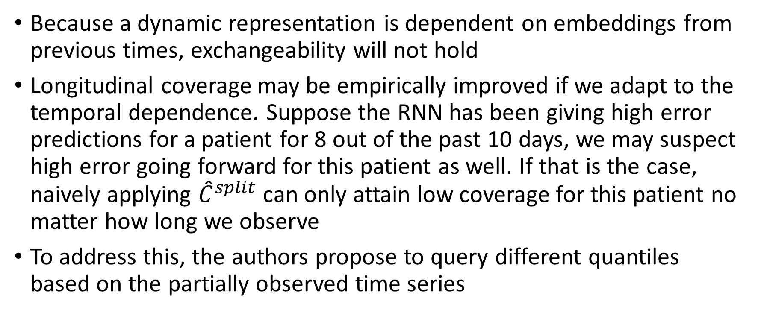
Temporal Quantile Adjustment
Because a dynamic representation is dependent on embeddings from previous times, exchangeability will not hold
Longitudinal coverage may be empirically improved if we adapt to the temporal dependence. Suppose the RNN has been giving high error predictions for a patient for 8 out of the past 10 days, we may suspect high error going forward for this patient as well. If that is the case, naively applying ${\hat{C}}^{split}$ can only attain low coverage for this patient no matter how long we observe
To address this, the authors propose to query different quantiles based on the partially observed time series

Slide 9
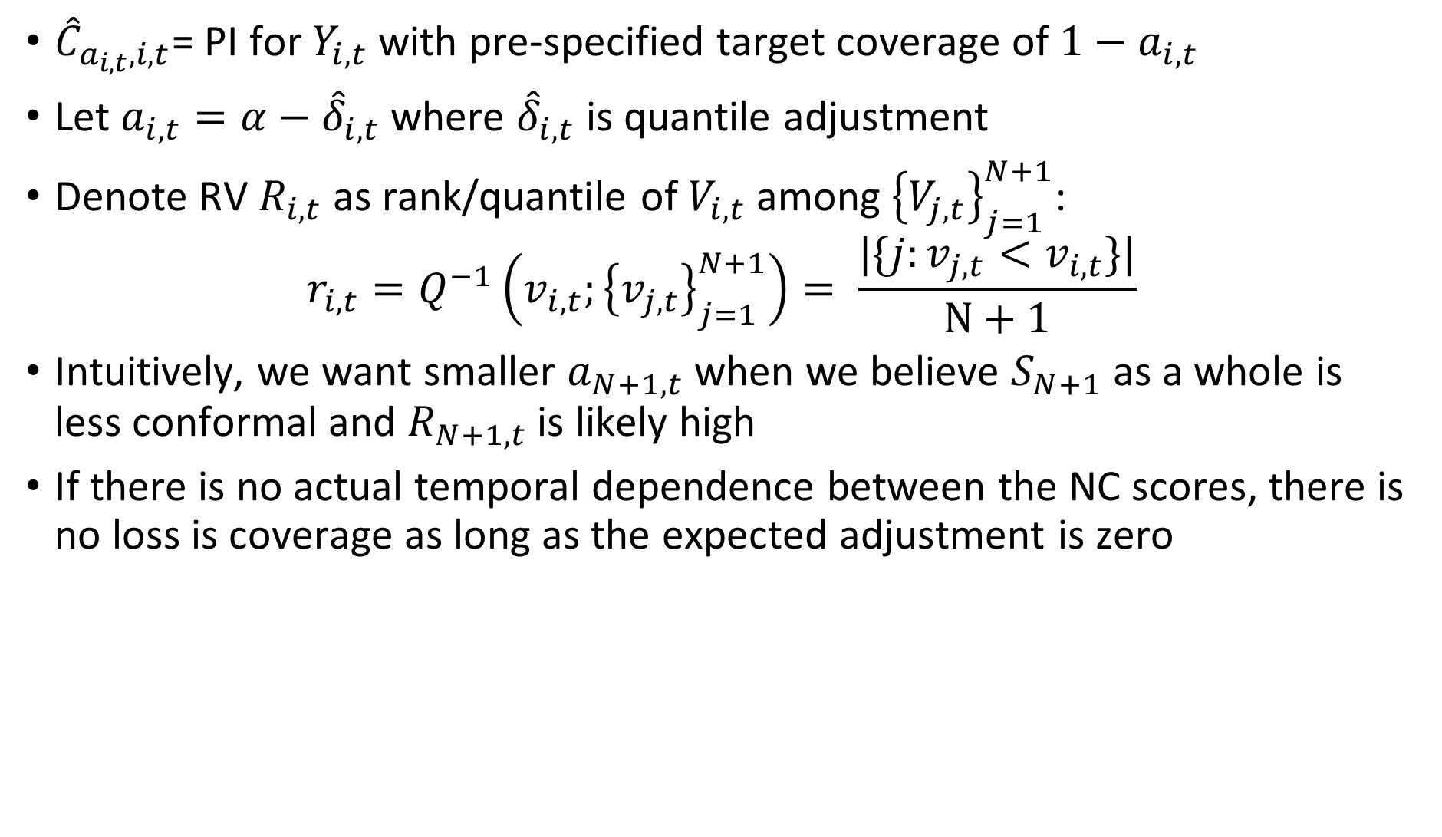
${\hat{C}}_{a_{i,t},i,t}$= PI for $Y_{i,t}$ with pre-specified target coverage of $1−a_{i,t}$
Let $a_{i,t}=α−{\hat{δ}}_{i,t}$ where ${\hat{δ}}_{i,t}$ is quantile adjustment
Denote RV $R_{i,t}$ as rank/quantile of $V_{i,t}$ among ${\left\{V_{j,t}\right\}}_{j=1}^{N+1}$:
$$r_{i,t}=Q^{−1}\left(v_{i,t};{\left\{v_{j,t}\right\}}_{j=1}^{N+1}\right)= \frac{|\{j:v_{j,t}<v_{i,t}\}|}{N+1}$$
Intuitively, we want smaller $a_{N+1,t}$ when we believe $S_{N+1}$ as a whole is less conformal and $R_{N+1,t}$ is likely high
If there is no actual temporal dependence between the NC scores, there is no loss is coverage as long as the expected adjustment is zero

Slide 10
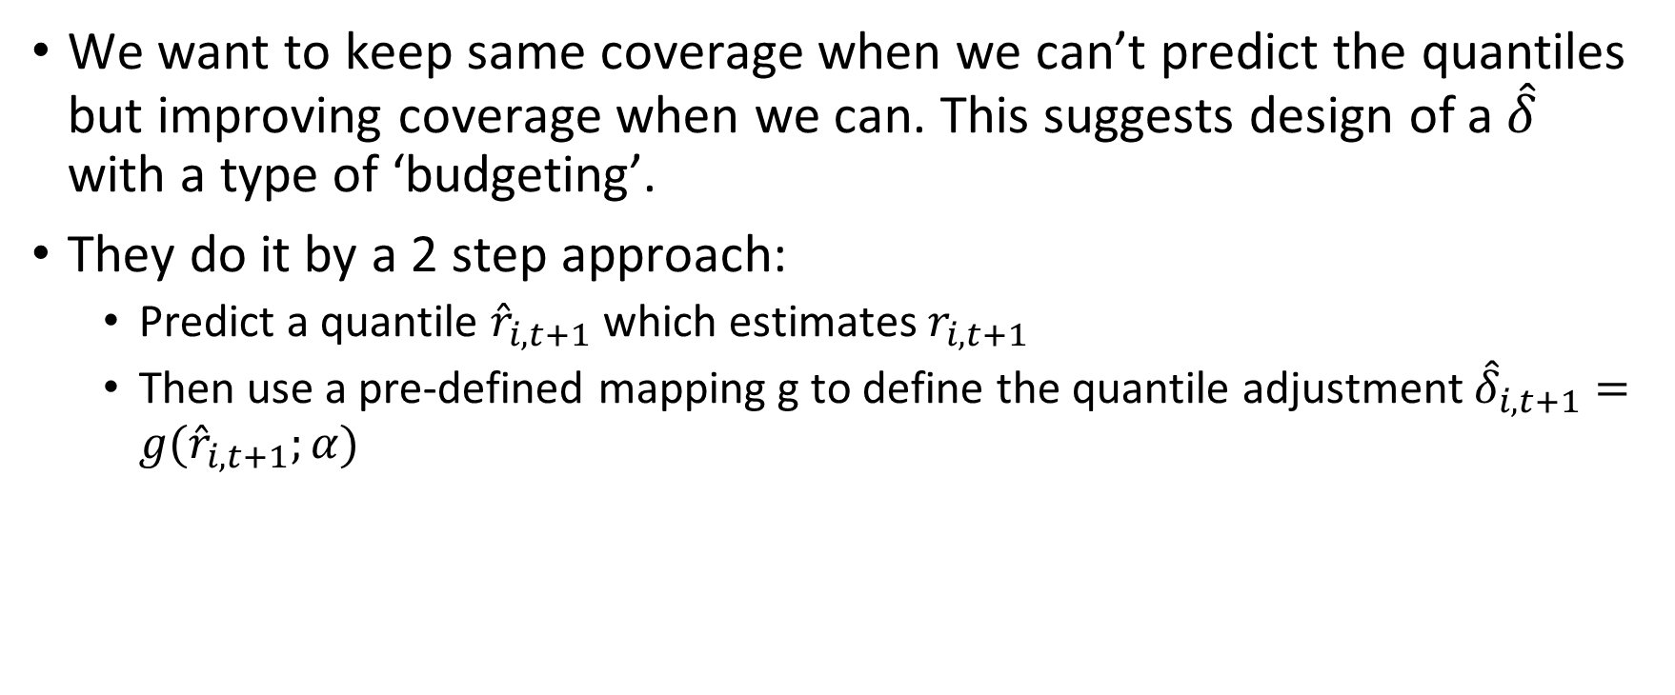
Quantile Budgeting (TQA-B)
We want to keep same coverage when we can’t predict the quantiles but improving coverage when we can. This suggests design of a ${\hat{δ}}_{}$ with a type of ‘budgeting’.
They do it by a 2 step approach:
Predict a quantile ${\hat{r}}_{i,t+1}$ which estimates $r_{i,t+1}$
Then use a pre-defined mapping g to define the quantile adjustment ${\hat{δ}}_{i,t+1}=g({\hat{r}}_{i,t+1};α)$

Slide 11

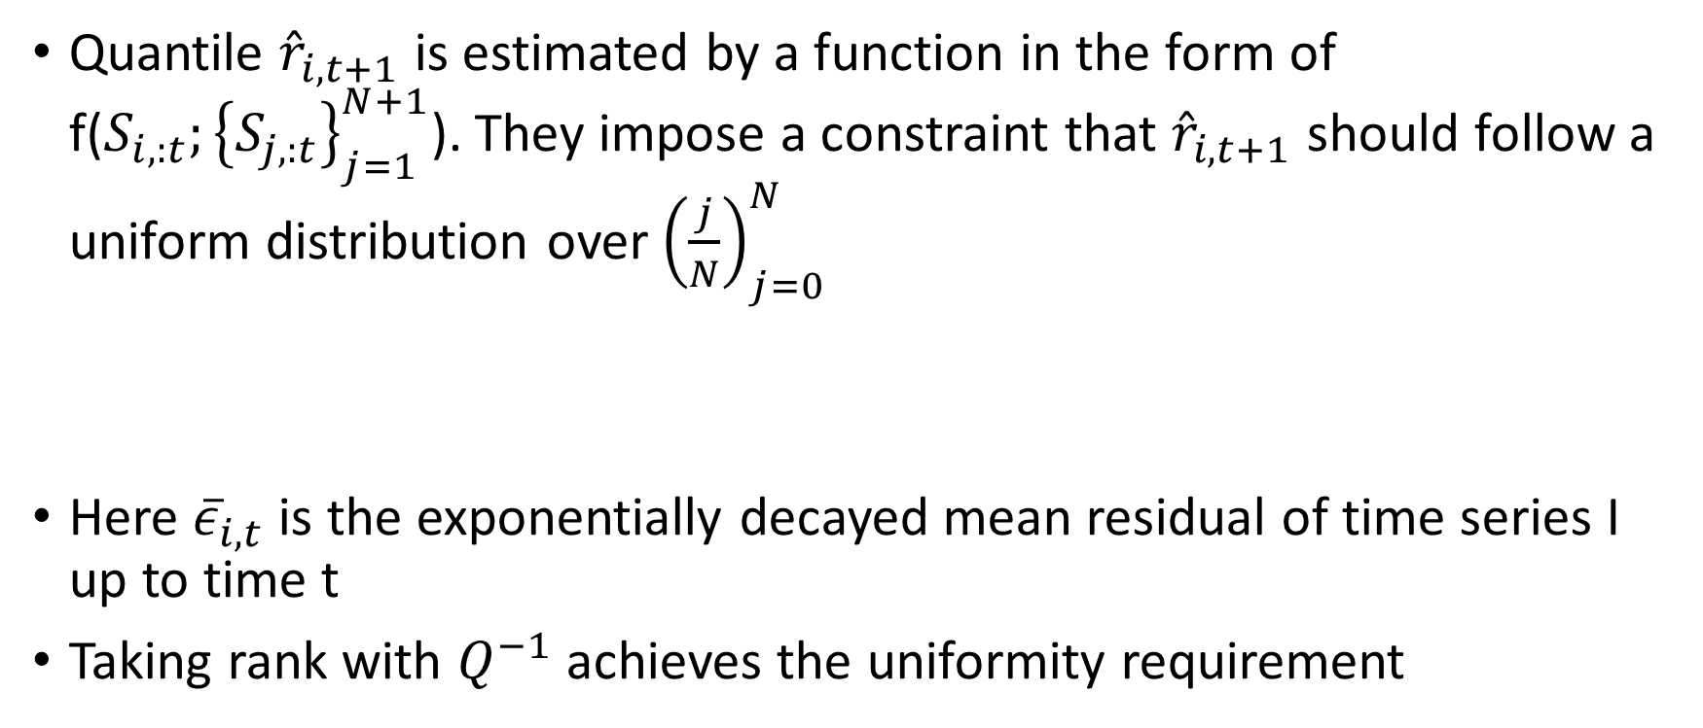
Quantile Prediction
Quantile ${\hat{r}}_{i,t+1}$ is estimated by a function in the form of f($S_{i,:t};{\left\{S_{j,:t}\right\}}_{j=1}^{N+1}$). They impose a constraint that ${\hat{r}}_{i,t+1}$ should follow a uniform distribution over ${\left(\frac{j}{N}\right)}_{j=0}^{N}$
Here ${\overline{ε}}_{i,t}$ is the exponentially decayed mean residual of time series I up to time t
Taking rank with $Q^{−1}$ achieves the uniformity requirement

Slide 12

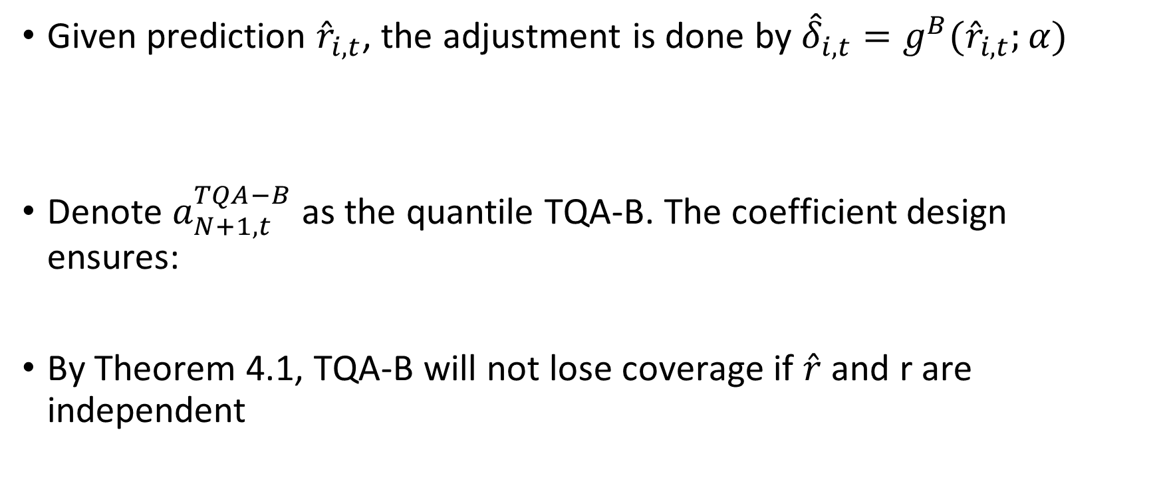
Budgeting
Given prediction ${\hat{r}}_{i,t}$, the adjustment is done by ${\hat{δ}}_{i,t}=g^{B}({\hat{r}}_{i,t};α)$
Denote $a_{N+1,t}^{TQA−B}$ as the quantile TQA-B. The coefficient design ensures:
By Theorem 4.1, TQA-B will not lose coverage if $\hat{r}$ and r are independent

Slide 13

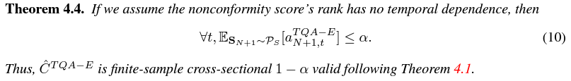
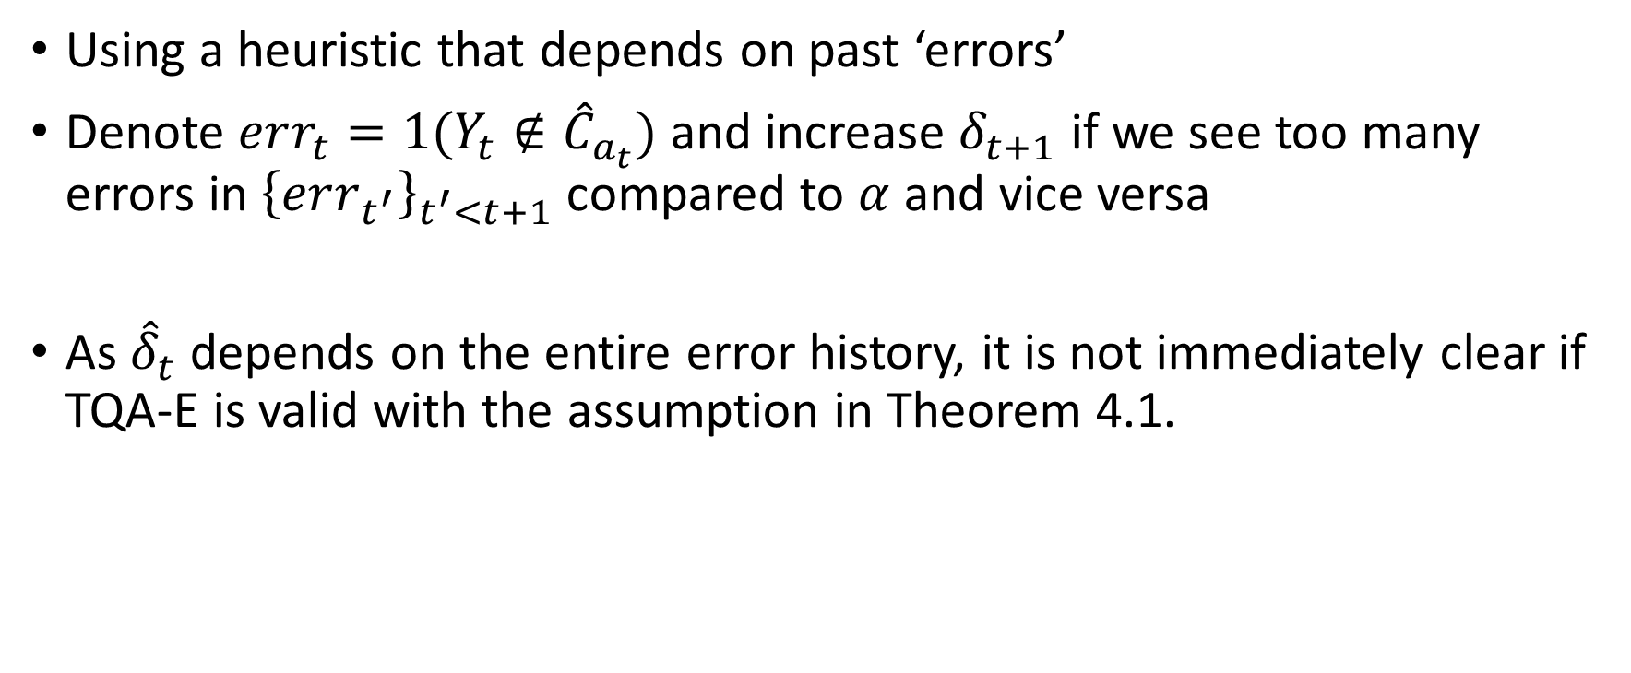
Error-based Adjustment (TQA-E)
Using a heuristic that depends on past ‘errors’
Denote $err_{t}=1(Y_{t}∉{\hat{C}}_{a_{t}})$ and increase $δ_{t+1}$ if we see too many errors in ${\left\{err_{t^{′}}\right\}}_{t^{′}<t+1}$ compared to $α$ and vice versa
As ${\hat{δ}}_{t}$ depends on the entire error history, it is not immediately clear if TQA-E is valid with the assumption in Theorem 4.1.

Slide 14
Experiments
Goals:
TQA maintains cross-sectional coverage and achieves competitive PI efficiency
Ignoring temporal dependence in naïve split conformal prediction leads to low longitudinal coverage for some TS
TQA improved longitudinal coverage
Metrics:
Average coverage rate: The proportion of Y that falls in the corresponding Ĉ (over all i and t)
Tail coverage rate: like average coverage rate, but only look at the least-covered 10% of all time series (i.e., the performance on the most difficult time series)
Inverse efficiency: average PI width divided by the average coverage rate. We prefer lower inverse efficiency because it means the PI could achieve the desired coverage with narrower intervals

Slide 15
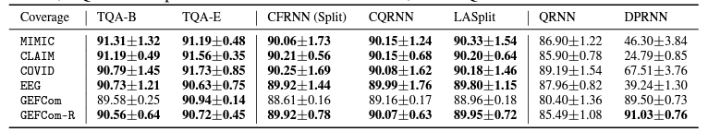
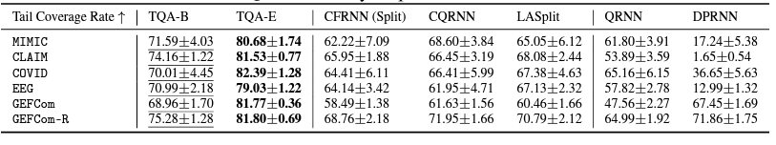
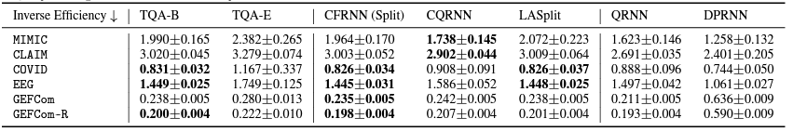
Results
Temporal Quantile Adjustment, or TQA, creates prediction intervals in time series forecasting with a cross-section.
TQA belongs to the conformal prediction framework, and the main idea is to adjust the quantile to query using temporal information collected so far.
This allows TQA to work with any model and any nonconformity score design.

